Slide 1
SmartBites:
Nutritional Clustering and Recommender System for Healthier Food Choices
By Margvinatta Senesie

Slide 2
One Word that explains my research is “Choice”

Slide 3
The Big Picture (AND..)
1
We are surrounded by food data and bad choices
1 in 2 U.S. adults have diet-related chronic disease
Nutrition labels are confusing or misleading
Food apps rarely recommend based on nutrient composition

Slide 4
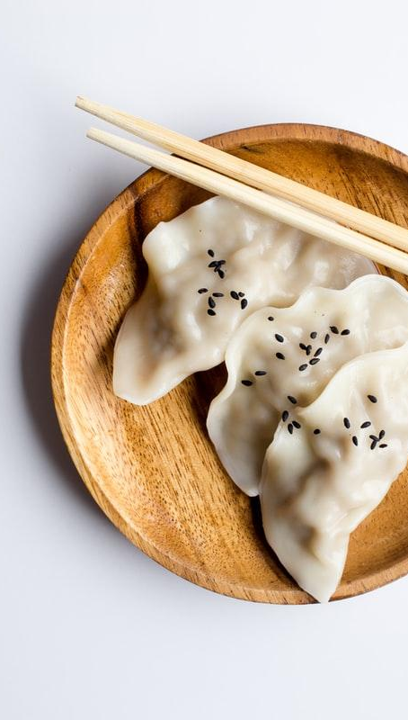
The Problem (BUT..)
Data alone doesn’t translate to smarter eating
Data is Overwhelming
No Standard scoring system
Nutrient balance isn’t obvious

Slide 5

The Approach
(THEREFORE..)
I built a Data-Driven Food Recommender
Cleaned & standardized nutrient data
Created a health score
Applied unsupervised clustering
Used cosine similarity to suggest alternatives

Slide 6
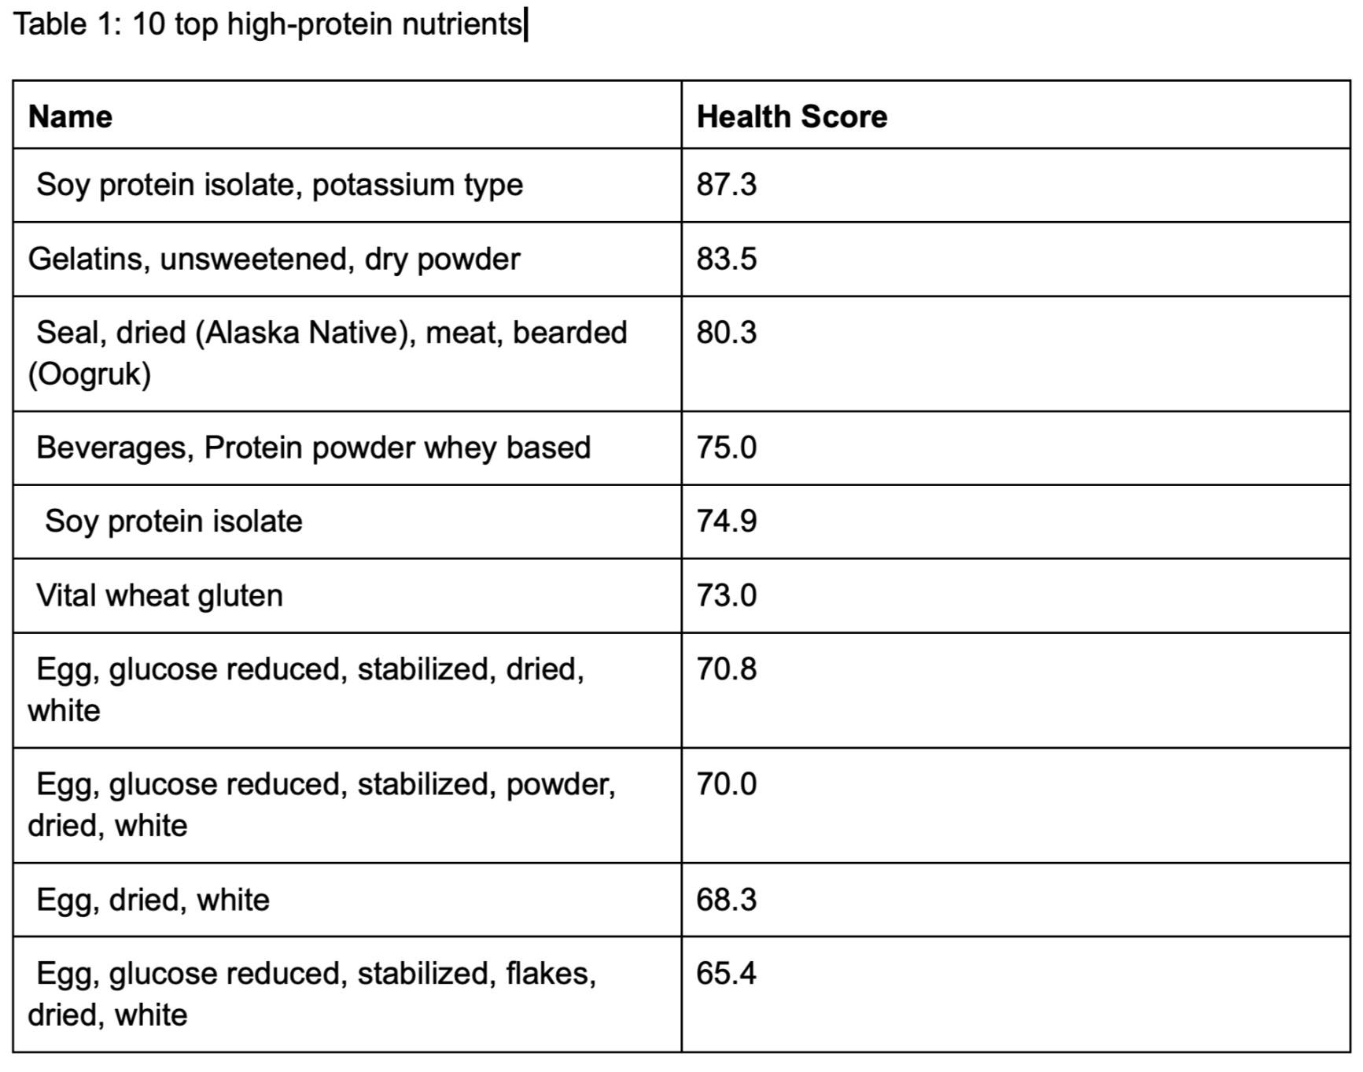
Health Score Model
Health Score = Protein − (Total Fat + Sodium / 100)
Prioritizes high-protein, low-fat, low-sodium foods
Top ranked foods: soy protein isolate, egg whites, gelatin powder

Slide 7
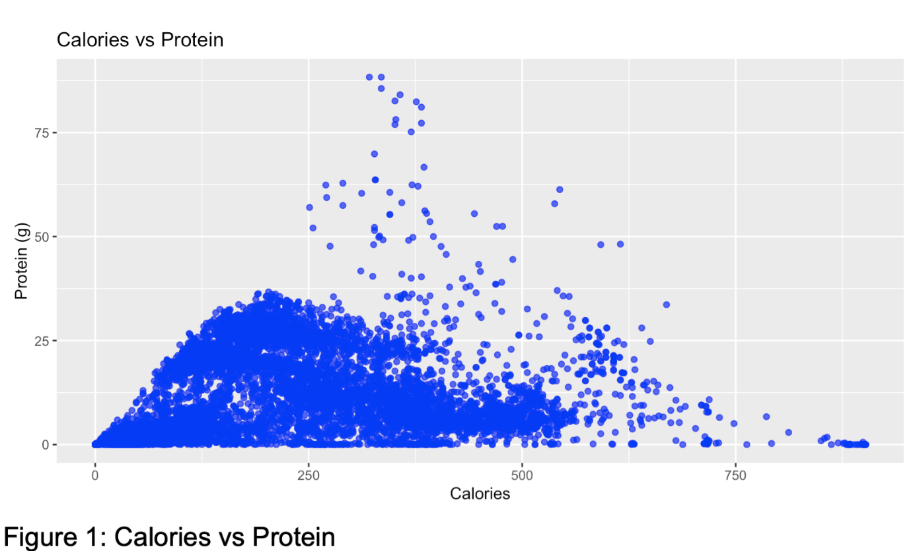
Visual Insight 1
Show Most items cluster between 100–300 calories and 0–30g protein.
But outliers like protein powder stand out with high protein and moderate calories. This supported protein as a key part of my scoring logic.

Slide 8
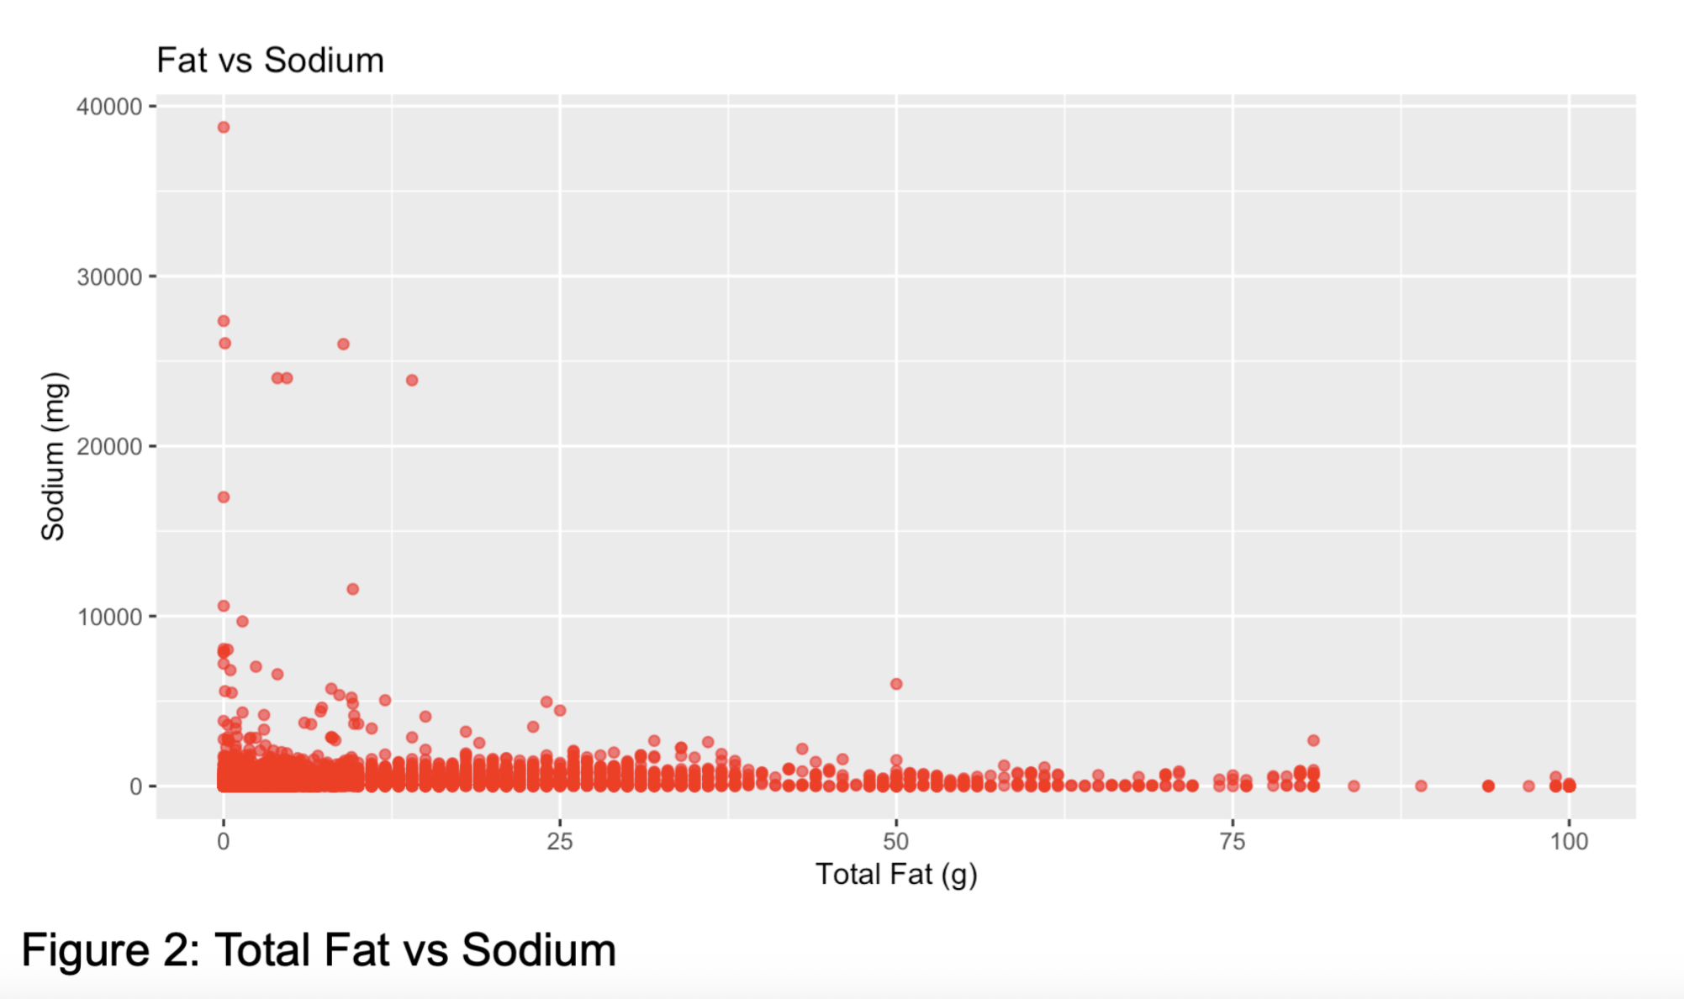
Visual Insight 2
Foods with extreme sodium levels (30,000+ mg) are visible here.
These tend to be processed foods. This justified penalizing high sodium in the score.

Slide 9
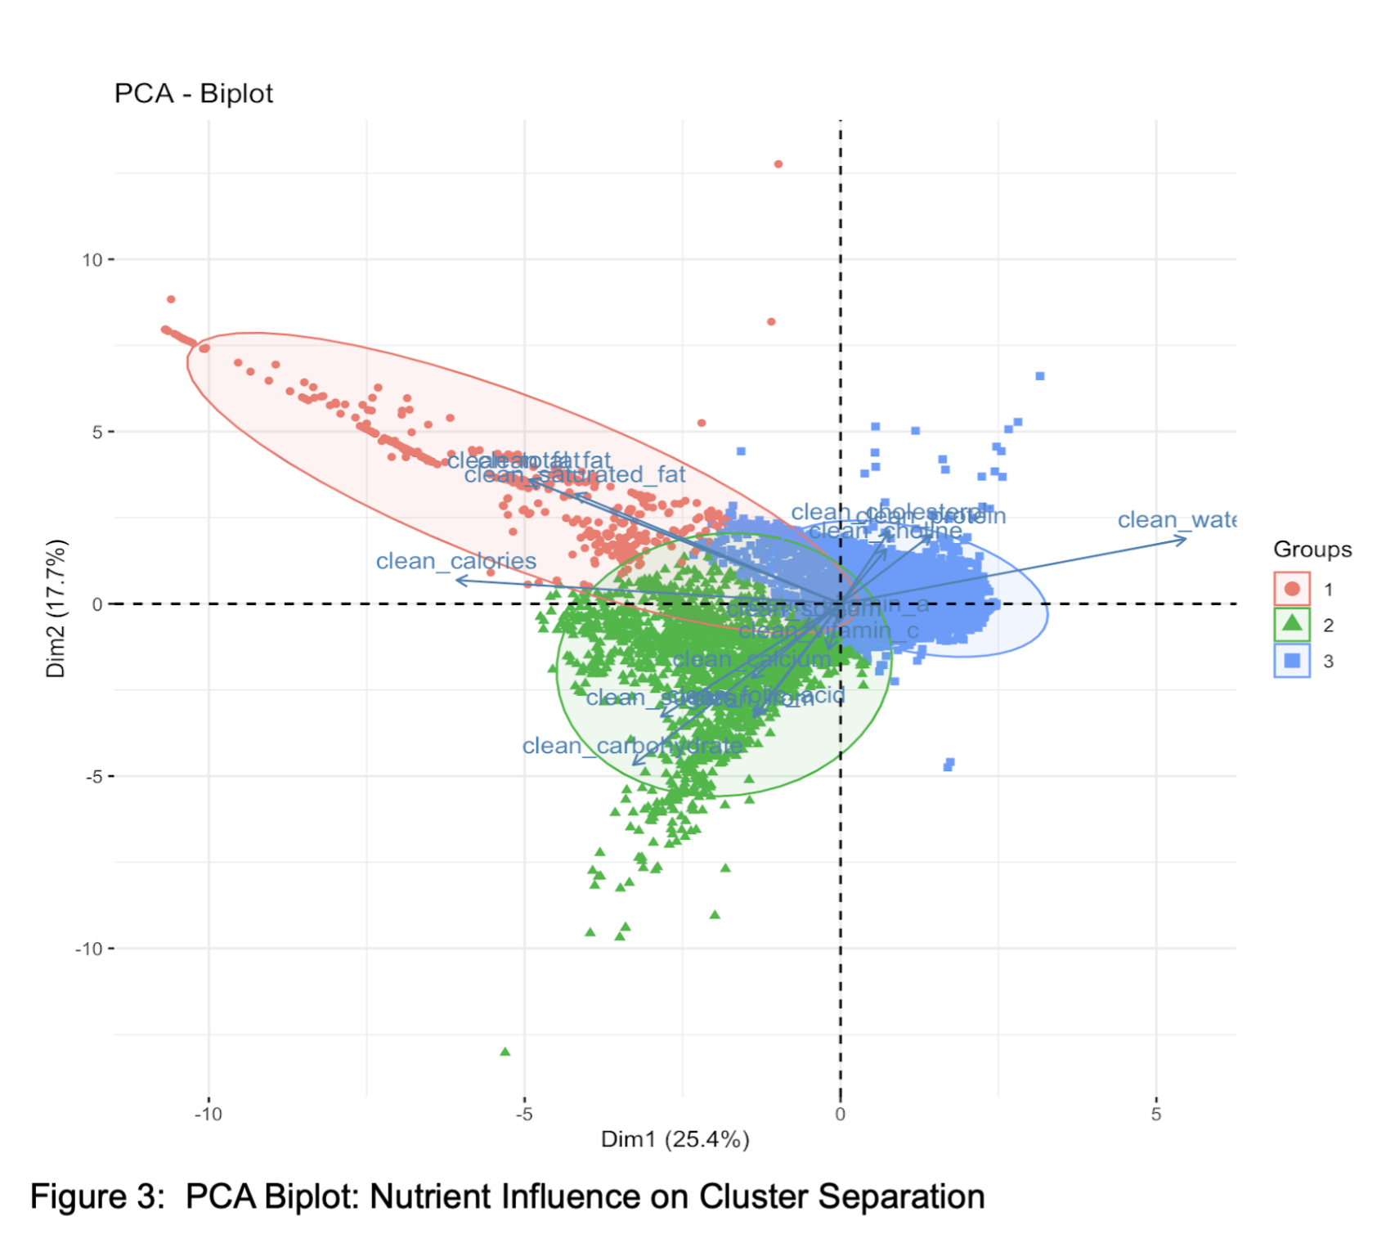
PCA Biplot
This biplot shows how each nutrient contributed to the clustering.
For example, protein and water pushed items toward Cluster 3. Fat and calories pointed to Cluster 1.

Slide 10
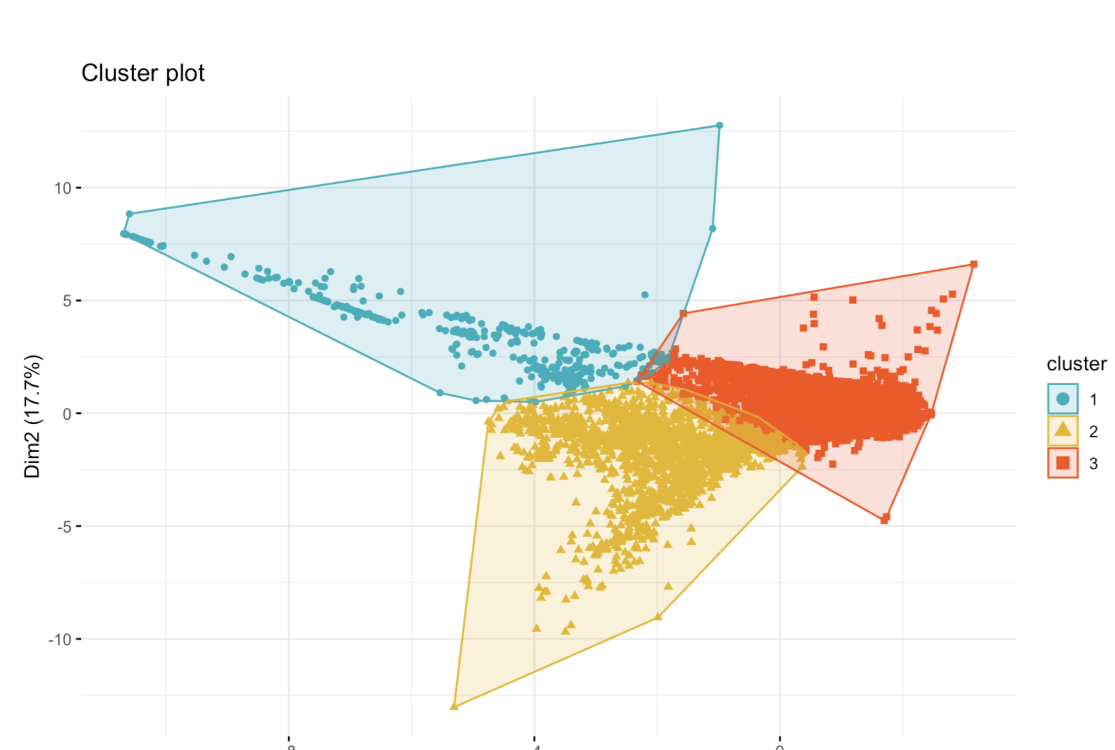
K-means Cluster Plot
This clearly shows three distinct clusters.
Blue is high-protein and clean. Yellow is mixed. Red is high-calorie, high-fat. It validated my clustering approach.
.

Slide 11
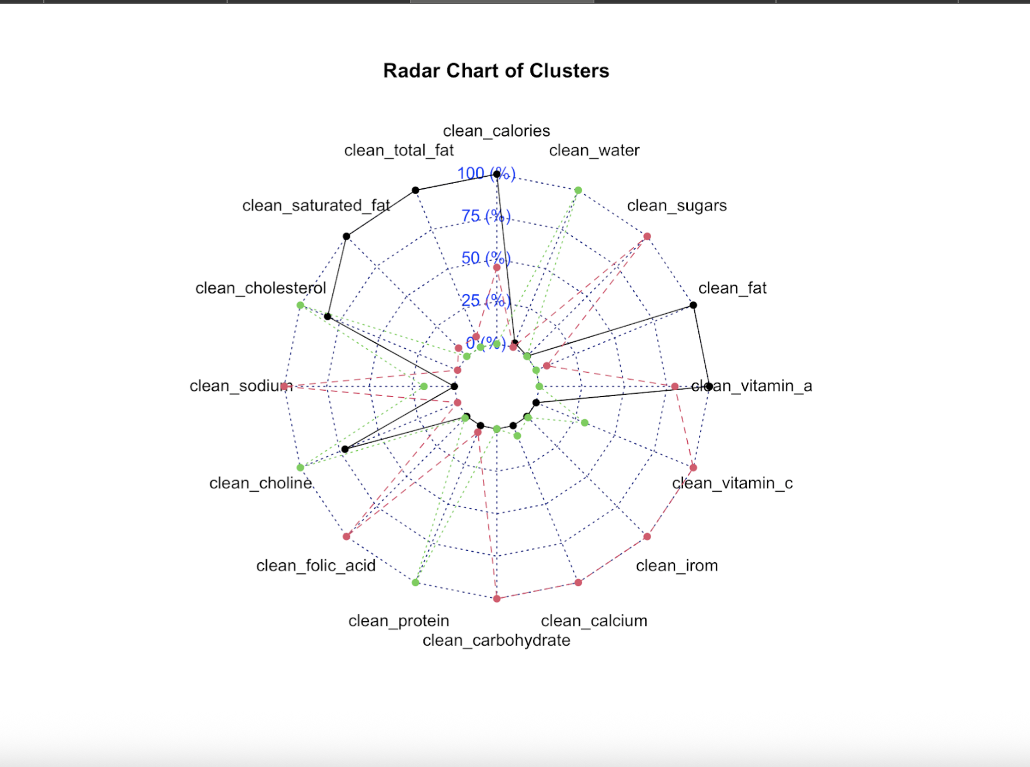
Radar Chart
This is a summary of each cluster’s average nutrient profile.
Cluster 1 is highest in fat, calories, saturated fat.
Cluster 3 is highest in protein, lowest in sodium.
.

Slide 12
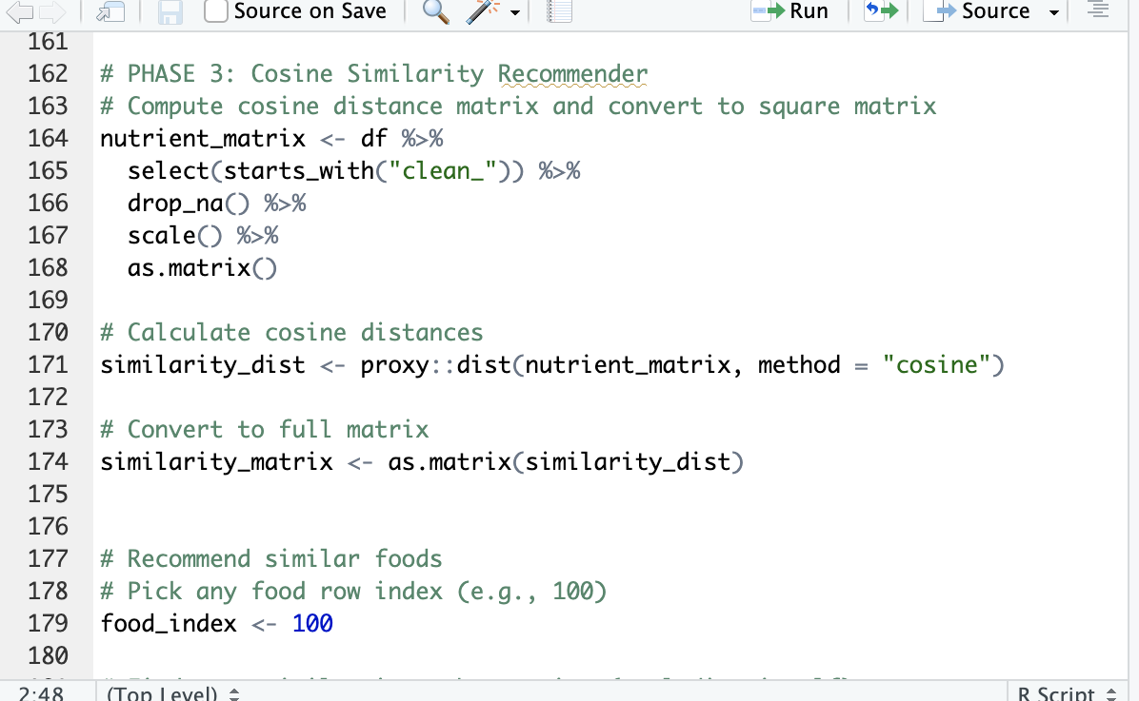
Recommender System
Suggesting Healthier Substitutes with Cosine Similarity
Compares nutrient profiles to suggest better alternatives
Example: healthy granola recommendations

Slide 13
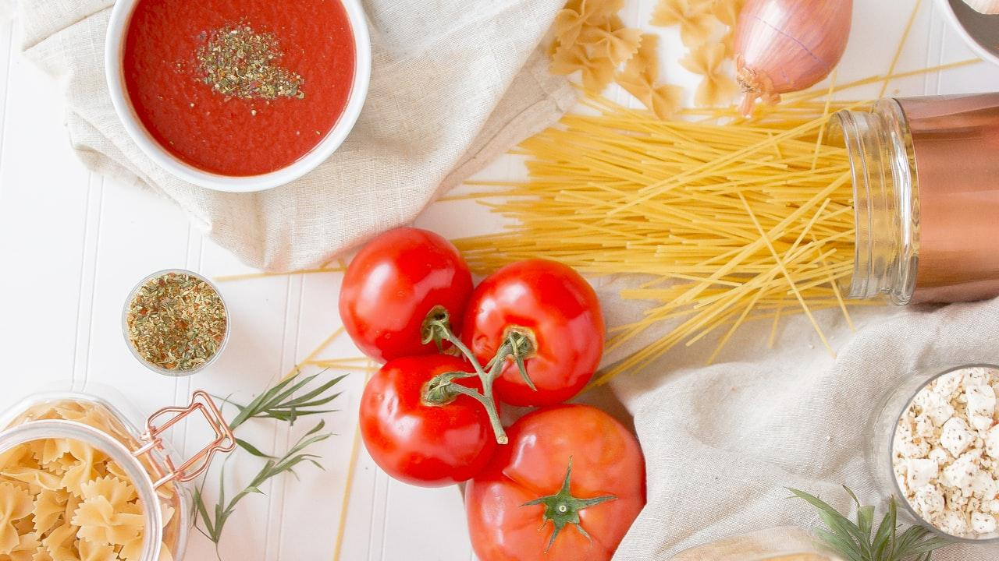
From Data to Decisions
Personalized nutrition
Opportunity for mobile app integration
Limits: subjective scoring, no fiber/sugar weighting

Slide 14
References
Harvard T.H. Chan School of Public Health. (2023). Protein: Moving the meat off your plate. https://www.hsph.harvard.edu/nutritionsource/what-should-you-eat/protein/
James, W. P. T. (2008). The epidemiology of obesity: The size of the problem. Journal of Internal Medicine, 263(4), 336–352. https://doi.org/10.1111/j.1365-2796.2008.01922.x
R Core Team. (2024). R: A language and environment for statistical computing (Version [insert version number if known]) [Computer software]. R Foundation for Statistical Computing. https://www.r-project.org/
SmartBites. (2022). SmartBites – Nutritional information of 8,789 foods [Data set]. Kaggle. https://www.kaggle.com/datasets/therealsampat/food-nutrition-data
Wickham, H., & Grolemund, G. (2016). R for data science. O’Reilly Media.

Slide 15


Thanks!
GitHub: https://github.com/Margvinatta/Final-DSSA-research-project
Any questions?
Notes:
Thanks to SLides Carnival, all of you and R packages that made my life easier.

